Slide 1

How to build a Serverless Helmet detection system using Custom Vision, Azure Functions, Event Grid and Logic Apps
Mandar Dharmadhikari

Slide 2





Who Am I?
Integration Developer and Administrator
Integration and AI enthusiast
TechNet Wiki Ninja and Author
Reviewer For Packt Video Courses
Die Hard Metallica, Dragon Ball and GOT fan
Mandar Dharmadhikari
https://www.linkedin.com/in/mandar-dharmadhikari/
@mandark003
https://theabodeofcode.com/
mandardhikari@gmail.com
https://github.com/mandardhikari

Slide 3
Takeaways from the Session
Azure Custom Vision Service
Azure Computer Vision Service
Logic Apps
Azure Functions
Event Grids
System Architecture
Code Peek and Demo
Using Application Insights to Monitor the System
Some Best Practices
Further Reading

Slide 4





Azure Custom Vision Service
Characteristics
Build, Deploy and Improve Custom Image Classifier
Custom Vision allows us to apply Labels to the images according to our requirements
Supports Object Detection and Classification
Several Out of the Box Algorithms for Different scenarios
Supports in portal and SDK based development
Export the Model and run on the Device or as Containerized App
Development Cycle
Upload Images
Tag Images
Train the Model
Test

Slide 5




Azure Computer Vision Service
Analyse Image Using Pre Existing Algorithm
Extract Text From Images – OCR and Handwritten
Recognize Famous Personalities
Generate Thumbnails
Supports ASP.NET, Python SDK and REST based consumption
Apps can be deployed to Azure or Can be run as Containerized apps closer to data

Slide 6

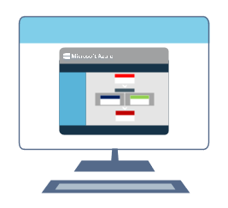
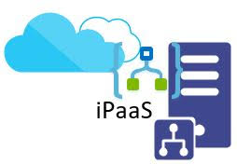

What Are Logic Apps
Data
Enterprise
B2B
Application
Integrations
Designer First Approach
Out of the Box Connectors for light weight Integrations
Integration Platform as a Service
Serverless

Slide 7


Why Use Logic Apps
Serverless integration
Connect Legacy System to new Cutting edge systems
Reduced time to release
iPaas : Reduced Operational cost
Pay for what you use
Easy to design using portal and Visual Studio
Easy deployment with ARM templates
Ability to set up CI and CD
Around300 Out of Box Connectors for API consumption
Ability to create Custom connectors

Slide 8




What Are Azure Functions?
Serverless Compute Service
Plethora of Triggers and Bindings
Multi Lingual
Developer Oriented
Supports Local Development and Debugging
Can be Run As Containerized App

Slide 9
Azure Functions Now Supports .Net Core based Dependency Injection
No More Static Functions

Slide 10
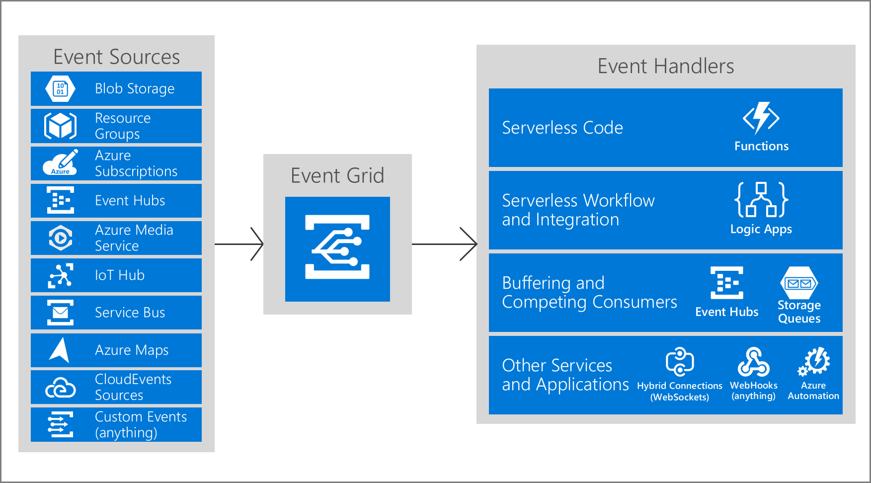
Azure Event Grid
Fully Managed Event Routing Service
Helps build event driven solutions using Pub-Sub Model
Promotes Loosely Coupled Architecture style
Supports Built In as Well as Custom Events
Has a very High Throughput
Pay Per Event Billing Model
Fairly cheap

Slide 11
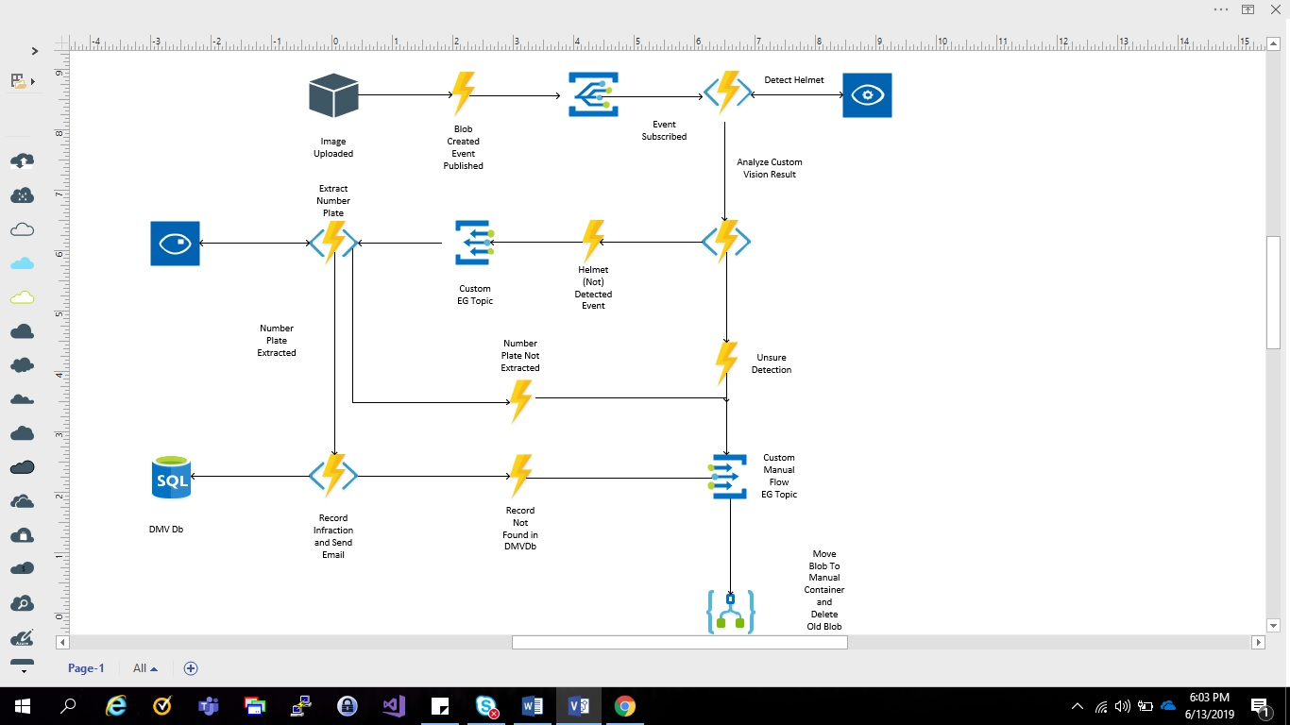
System Architecture

Slide 12
Code Peek and Demo

Slide 13
Why Use Application Insights?
Important Metrics related to the application
Visualize Disparate systems calls using Application Map
Real Time Telemetry
Query the Log Events using the Query Language Kusto

Slide 14
Some Best Practices And Lessons Learnt
Add at least 50 images per tag to better train the objection detection model in Custom Vision Service
Use a Static HTTP Client with Azure Functions
Use Singleton instances for API calls e.g Custom Vision, Computer Vision clients
Add Structured and Correlated Logging in Azure Function

Slide 15
Further Reading…
MSDN Documentation

Slide 16


Slide 17
Questions…

Slide 18
Let Us Connect
https://www.linkedin.com/in/mandar-dharmadhikari/
@mandark003
theserverlessspirit@wordpress.com
mandardhikari@gmail.com
https://github.com/mandardhikari

